Slide 1

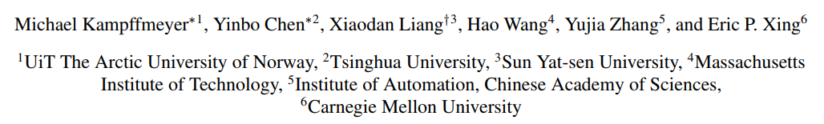
Rethinking Knowledge Graph Propagation
for Zero-Shot Learning
Paper: Rethinking Knowledge Graph Propagation for Zero-Shot Learning (thecvf.com)
Codes: https://github.com/cyvius96/adgpm

Slide 2
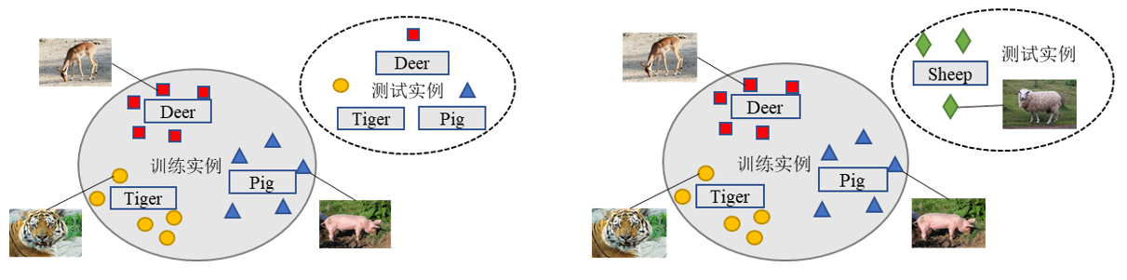
Introduction
Zero-shot learning(ZSL)
Use prior knowledge to classify images from unseen classes into correct categories based on semantic relationships between seen and unseen classes.
Supervised learning
Zero-shot learning

Slide 3
Introduction
Problems
Approaches that use knowledge graphs are less explored and generally assume that unknown classes can exploit similarity to known classes.
Recently, the benefit of hybrid approaches that combine knowledge graph and semantic class descriptions has been illustrated. However, deep GCNs may cause over-smoothing.

Slide 4
Introduction
Main contributions
Propose a Dense Graph Propagation (DGP) module with carefully designed direct links among distant nodes.
A novel weighting scheme for DGP where weights are learned based on the distance between nodes.
Obtain relative improvements of more than50% over previously reported best results

Slide 5
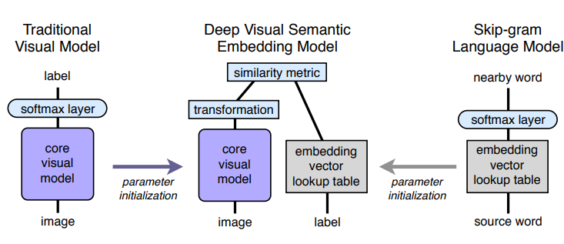
Related Work
DeViSE
A. Frome, G. S. Corrado, J. Shlens, S. Bengio, J. Dean,T. Mikolov, et al. Devise: A deep visual-semantic embedding model. NIPS 2013.
Notes:
Transformation – 一个矩阵M
t 是词向量，语义特征， v是图像特征， Mv将视觉向量投影到语义空间维度与t一致。因为向量都单位化了，两个向量相乘就代表两者的余弦距离

Slide 6
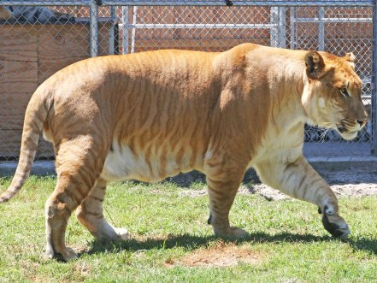
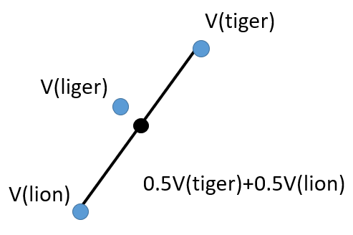

Related Work
ConSE
Liger
Most likely seen label for an image x
Lion 0.5
CNN
Tiger 0.5
Predicts a semantic embedding by t^{th} most likely training label’s embedding
Semantic Space
Predicts the unseen label for an image x
M. Norouzi, T. Mikolov, S. Bengio, Y . Singer, J. Shlens, A. Frome, G. S. Corrado, and J. Dean. Zero-shot learning
by convex combination of semantic embeddings. ICLR 2014.
Notes:
y(x, 1) – most likely training label for an image x
y0(x, t) – denote the t个 most likely trainning label for image x
ConSE基本继承了DeVise的结构，但是不同的是，对于CNN模块，DeVise将softmax层换成transformation，而devise保留了softmax，这样直接获得x的在seen labels中概率分布
In contrast, the ConSE model keeps the Softmax layer of the convolutional net intact, and it does not train the neural network any further. Given a test image, the ConSE simply runs the convolutional classifier and considers the top T predictions of the model

Slide 7
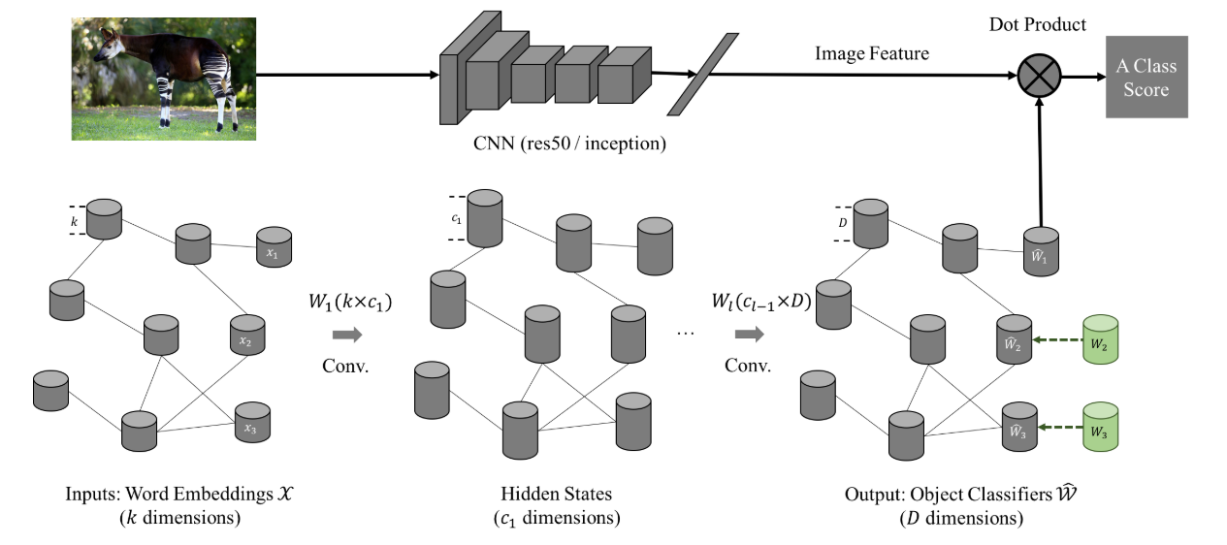

Related Work
GCNZ
Propagation
Loss
Wang X, Ye Y, Gupta A. Zero-shot recognition via semantic embeddings and knowledge graphs. CVPR 2018

Slide 8
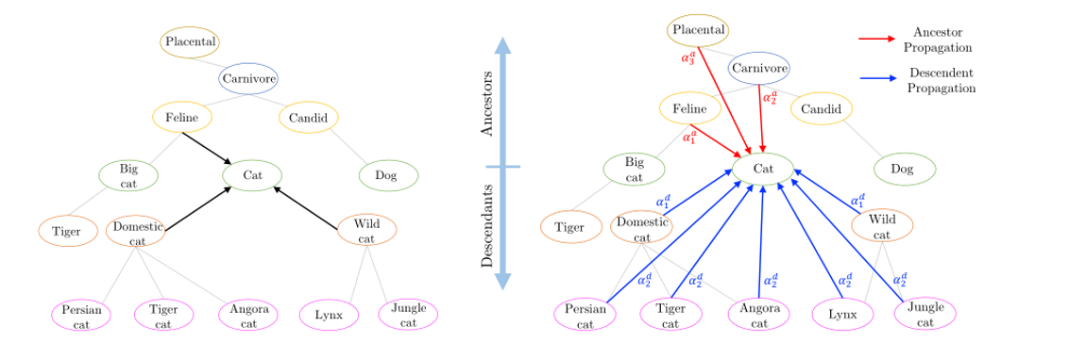


Method
Graph Propagation
Dense Graph Propagation

Slide 9
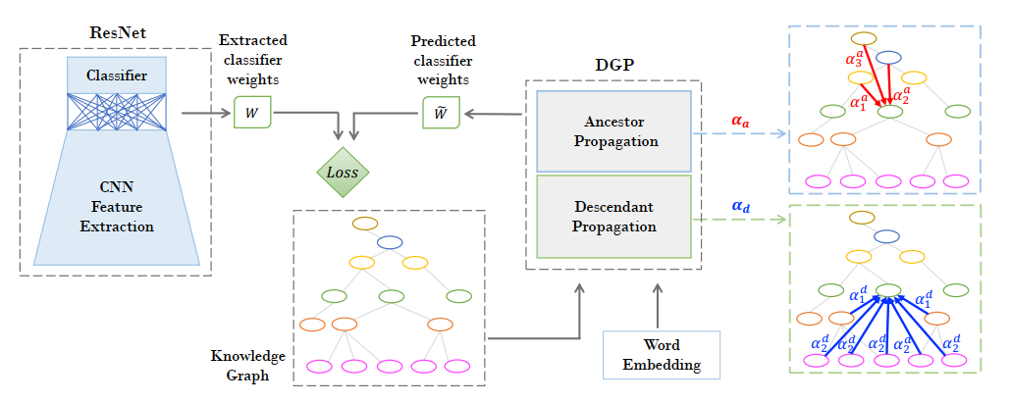

Method
Trainning
Test

Slide 10
Experiments
Dataset
ImageNet
2
Carnivore
食肉动物
seen classes 1000
1
3
Feline
Canine
2-hops
2
4
Big Cat
Cat
3-hops
Dog
3
all
1
1
Tiger
Domestic cat
Wild Cat

Slide 11
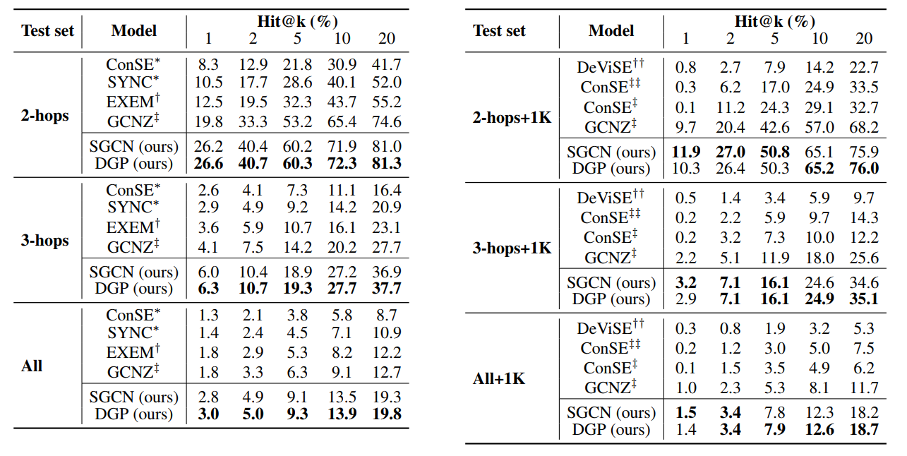
Experiments

Slide 12
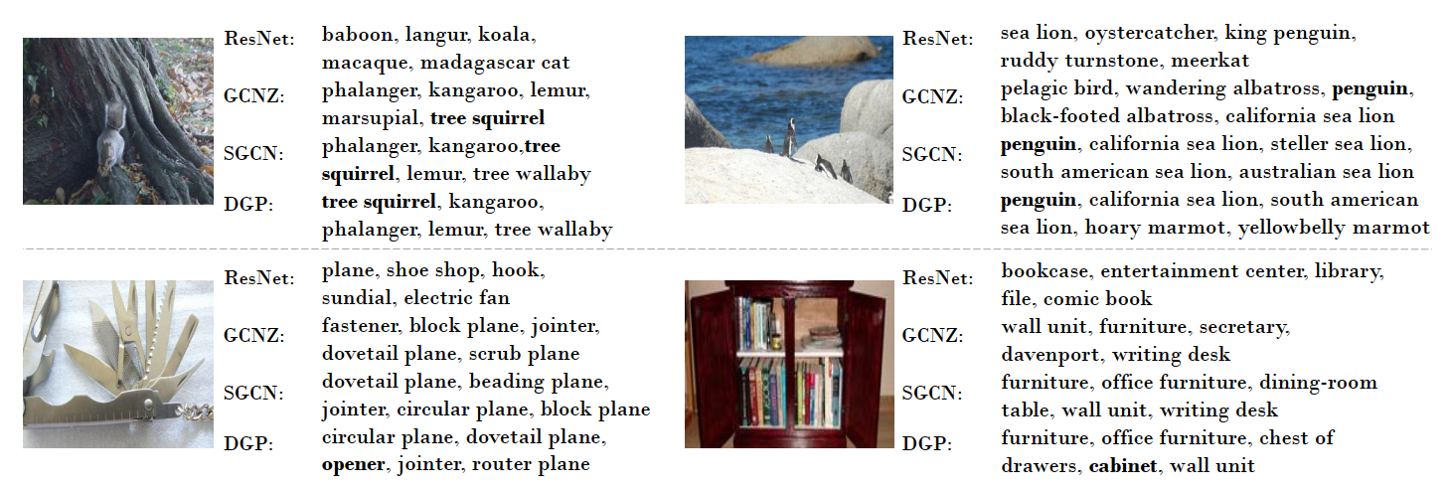
Experiments

